Slide 1
fMRI preprocessing and contrasts on SPM Julien Benistant & Valentin Guigon June 13th 2023

Slide 2
Preprocessing on SPM

Slide 3

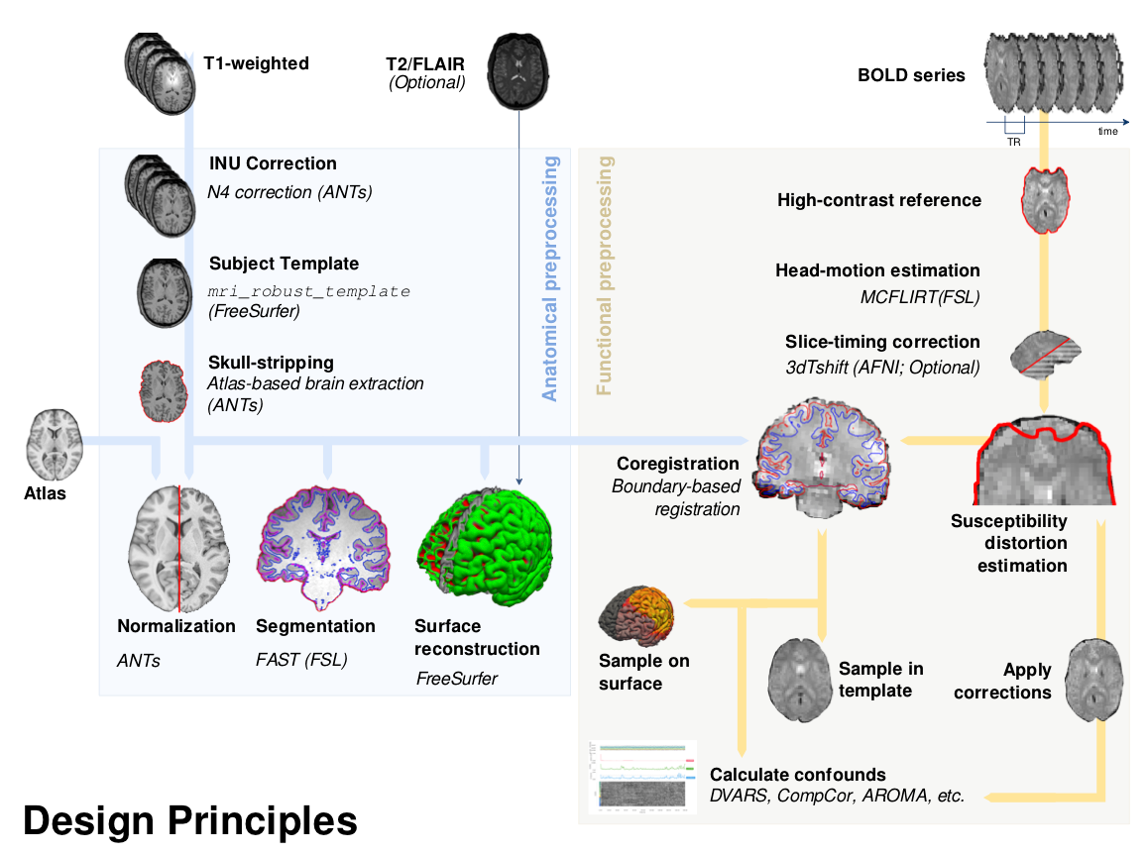
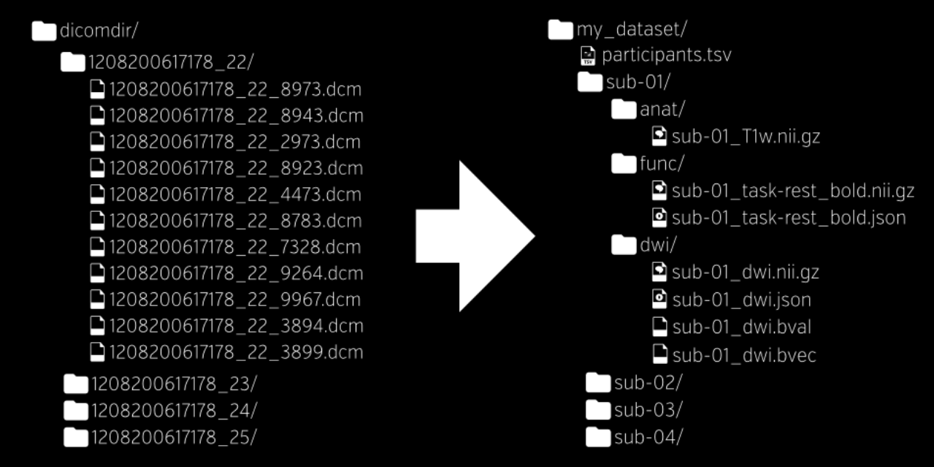
fMRIPrep & BIDs format
Recent, open standard, with protocol for organizing and describing imaging data
Notes:
Multiple neuroimaging tools: FSL, FreeSurfer, AFNI, SPM, etc.

Slide 4
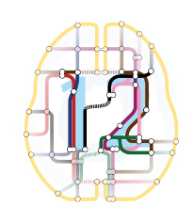
DICOM, NifTI & SPM
DICOM (Digital Imaging and Communications in Medicine, 1993) Current standard communication protocol used for the capture, storage and transmission of medical images and related data
NifTI (Neuroimaging Informatics Technology Initiative, NIH, 2003) A comprehensive data format used by imaging software but without a communication protocol
SPM (Matlab, 1991) One of the software specialized in analyzing NifTI images

Slide 5
Preprocessing: why is it needed?
fMRI Returns a 3D array of voxels repeatedly sampled over time, with changes in activation in each voxel correlated with experimental task
Key Assumptions:
1) The voxels need to come from the same part of the brain
2) All voxels must be acquired simultaneously
Assumptions violated:
Brain moves in the scanner
The last slice is acquired TR seconds after the first slice
Problem: These sources of variance lower the signal-to-noise ratio
Solution: Preprocessing such as slice-timing correction (assumption 2), realignment of images (assumption 1), etc.
Notes:
fMRI analysis looking at a 3D matrix of voxels repeatedly sampled over time
how fMRI works: We look at intensity of activation in a voxel at a given point of time. We plot this along with various tasks, and if activation varies with the task, we can correlate brain function.
To do this, first step we must ensure we are looking at same brain region over time.

Slide 6
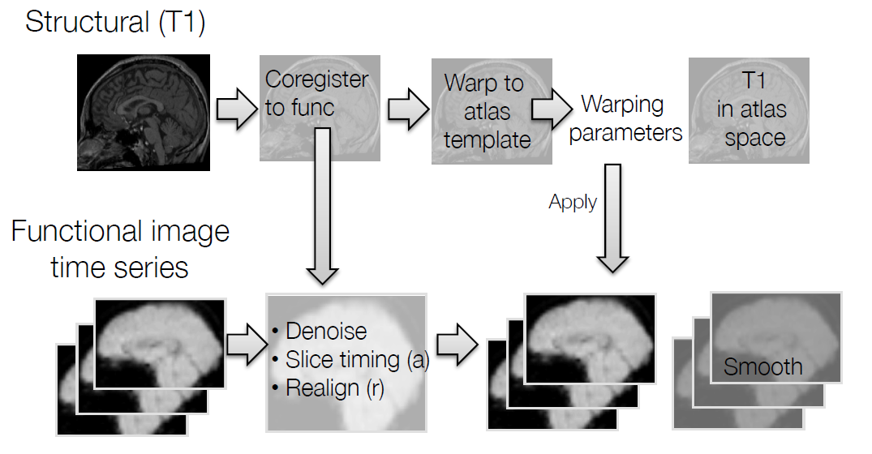
Data processing pipeline
Preprocessing
To minimize the influence of data acquisition and physiological artifacts
To check statistical assumptions and transform the data to meet assumptions
To standardize the locations of brain regions across subjects to achieve validity and sensitivity in group analysis.
Notes:
Prior to analysis, fMRI data undergoes a series of preprocessing steps aimed at identifying and removing artifacts and validating model assumptions

Slide 7
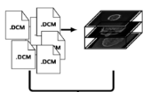
Pipeline: 1. DICOM to NifTI

Slide 8
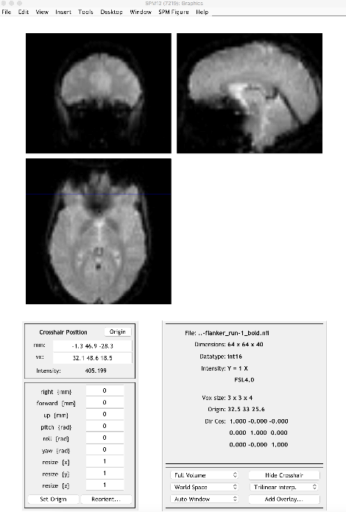
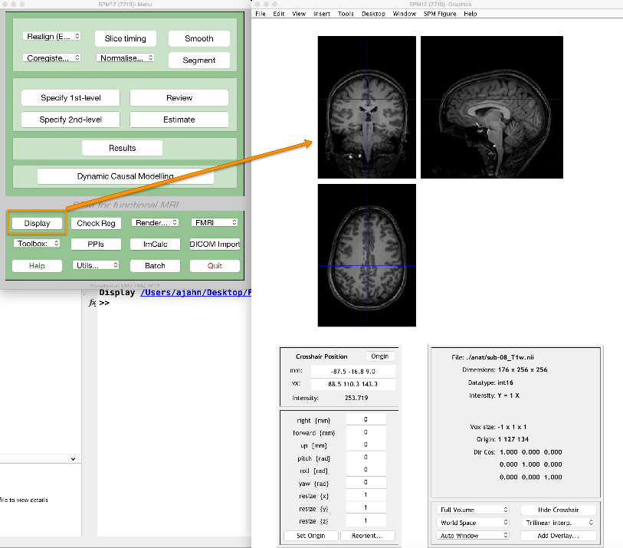
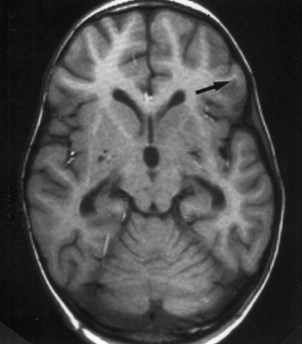
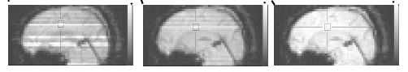
Pipeline: 2. Visualization
Inspect functional images
Inspect anatomical images
Look out for noise, transient artifacts, ghosting, dropouts, etc.
Look out for artifacts, such as ripples. They may be caused by subjects moving too much in the scanner

Slide 9
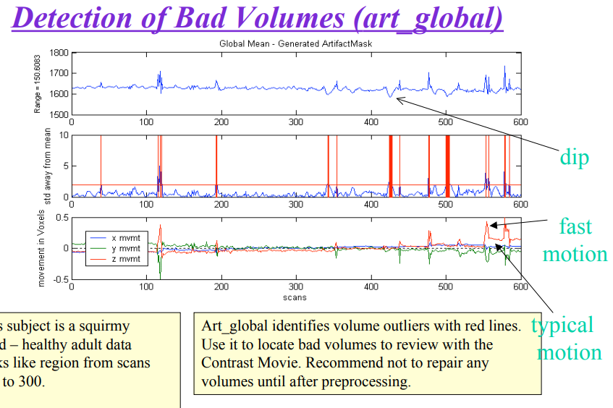
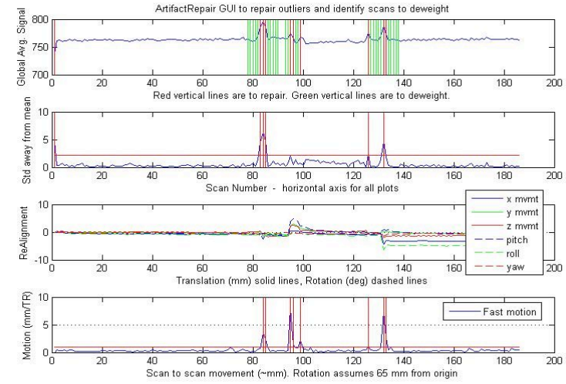
Pipeline: 3. Artifact removal (optional)
Can also be done at the end of preprocessing
Beware, previous versions included a script error that needed correction by-hand
https://cibsr.stanford.edu/content/dam/sm/cibsr/documents/tools/methods/artrepair-software/ArtRepairOverview.pdf

Slide 10
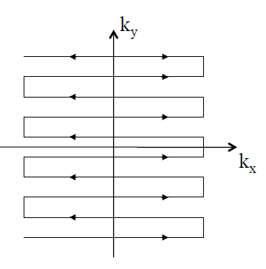
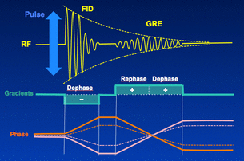
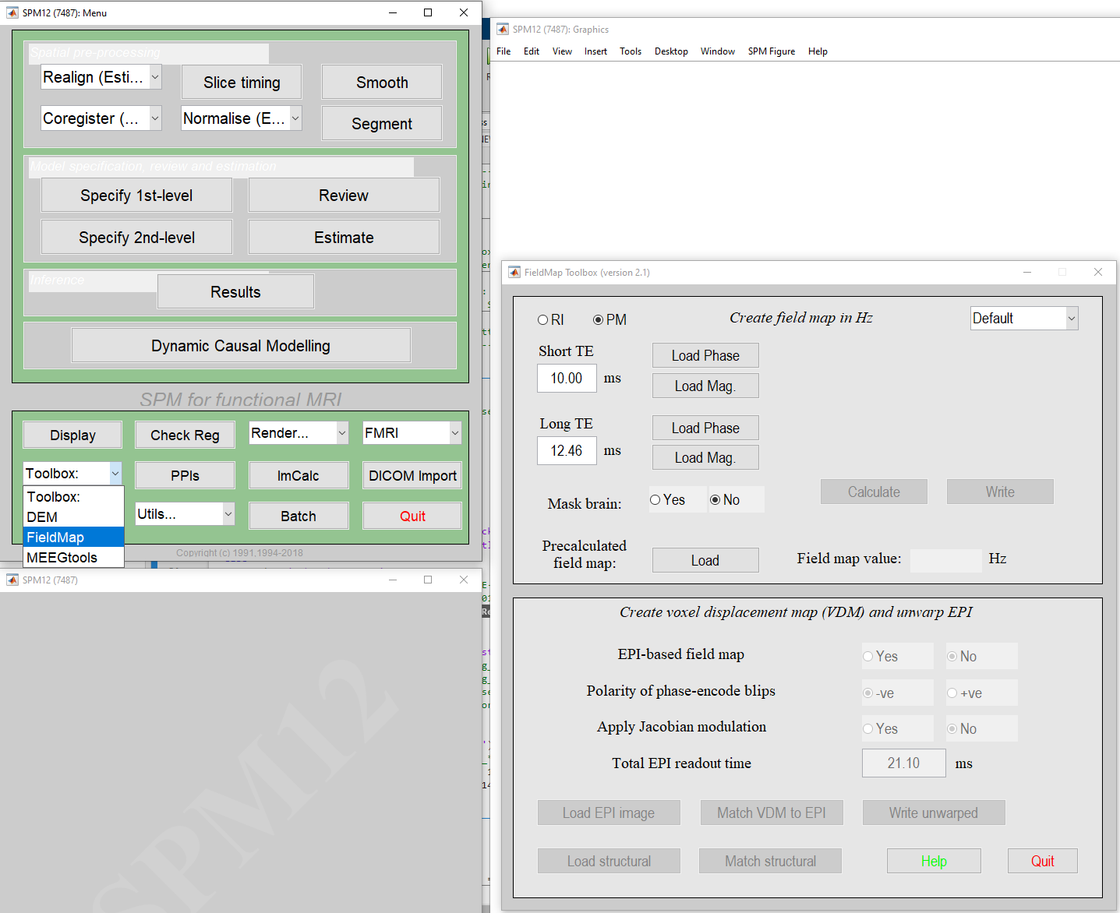
Pipeline: 4. Field Map
fMRI data is usually acquired via Echo Planar Imaging (EPI) for rapid acquisition times. The sequence acquires large amounts of gradient echoes in one TR cycle by rapidly alternating frequencies.
However, EPI is more sensitive to spatial disturbances (inhomogeneity) of the magnetic field, induced by ferromagnetic components of the magnet or the patient. The result is varying image quality + artifacts.
A fieldmap is a measure of such deviations. We use the Fieldmap toolbox to address the difference between two echoes, and to correct the distortions. The file will be used later in the preprocessing.
More at FSL Course: EPI Distortion Correction and Registration:
https://www.youtube.com/watch?v=DfGIZcEvQus
Notes:
In EPI, a gradient echo is formed in the broadening direction by applying an initial dephasing gradient, and then a series of 'blips' of the opposite polarity which form the echo. The time from the r.f. excitation pulse to the centre of the echo is defined as the echo time in EPI
Gradient echoes: variations of Radio Frequency (RF) pulses : RF is switched between positive and negative

Slide 11
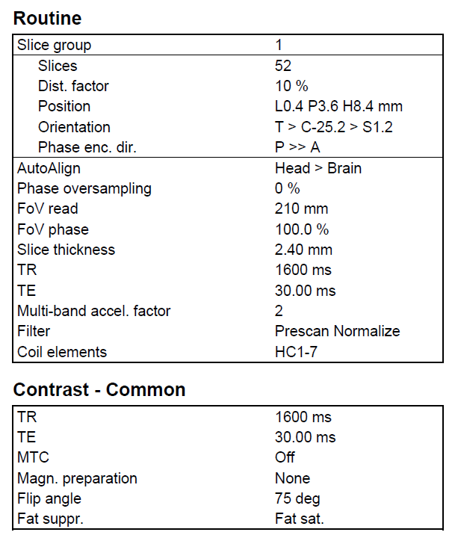
fMRI parameters example

Slide 12
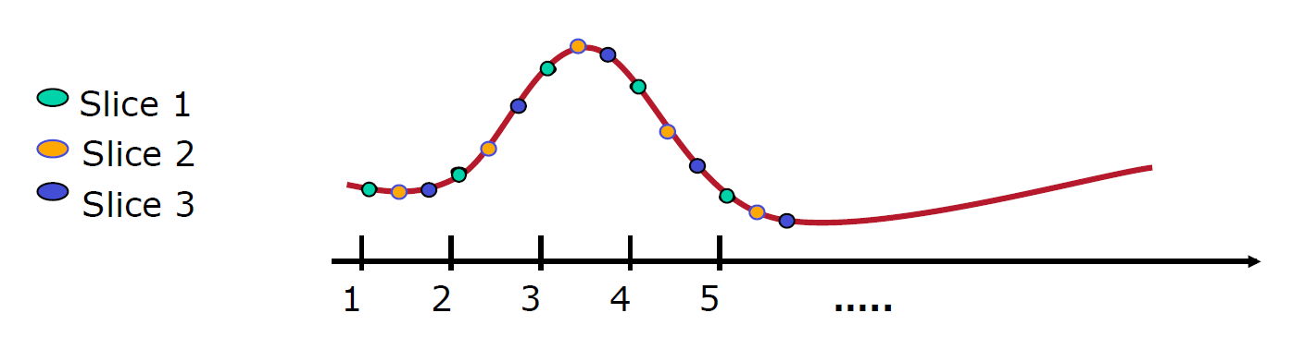
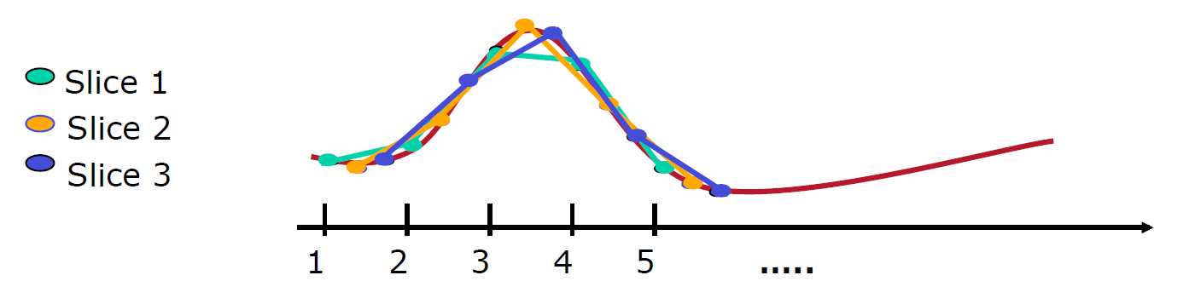
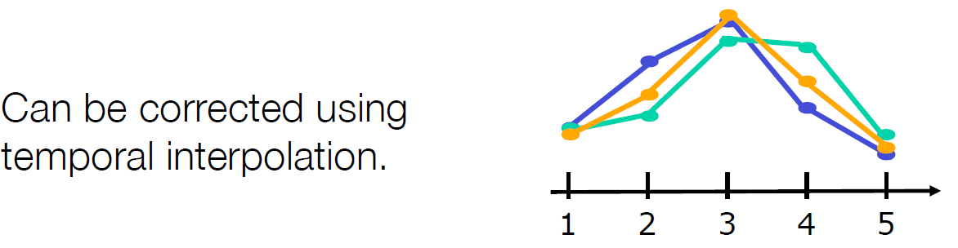
Pipeline: 5. Slice timing
Correcting assumption 2:
We construct brain volumes by sampling multiple slices of the brain during each individual repetition time (TR)
Each slice is sampled at a slightly different time points
• Slice time correction shifts each voxel's time series so that they all appear as sampled simultaneously.
Temporal Interpolation
Use information from nearby time points to estimate the amplitude of the MR signal at the onset of each TR

Slide 13
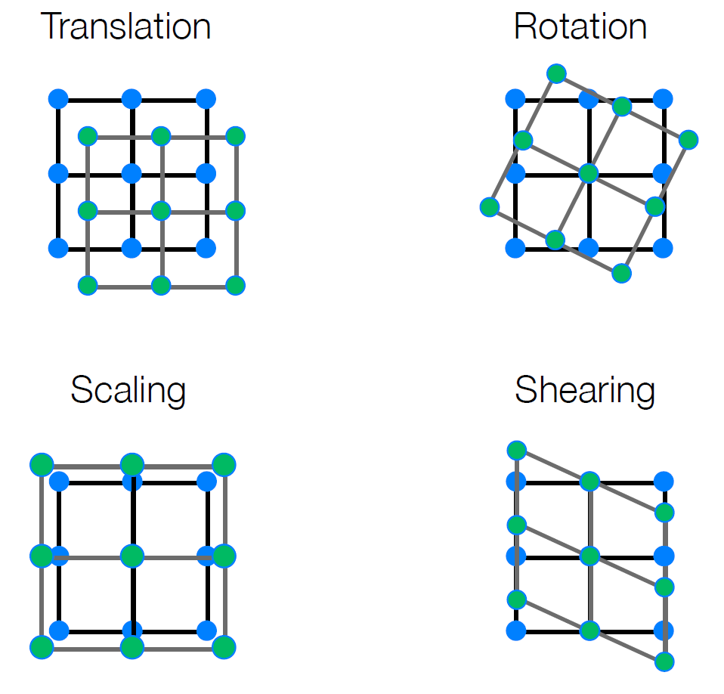
Pipeline: 6. Registration (Realign & unwarp)
Correcting assumption 1:
When analyzing the time series associated with a voxel, we assume it depicts the same region of the brain at every time point
Movements such as head motion may make this assumption incorrect
Realignment via linear transformations:
• Rigid body (6 DOF) – translation, rotation
• Similarity (7 DOF) – translation, rotation, global scaling
• Affine (12 DOF) – translation, rotation, scaling and Shearing
Unwarping:
Non-linear transformation to modify shape
We correct that by looking for the best possible alignment between an input image and some target image (i.e., registration):
We define a target image, usually defined the first or mean image in the fMRI time series
The goal is to find the set of parameters which minimizes some cost function that assesses similarity between the image and the target
To align the two images, one of them needs to be transformed via rigid body functions or non-linear functions
Notes:
Shearing: shears take the diagonally opposite corners of the image and stretch them away from each other

Slide 14
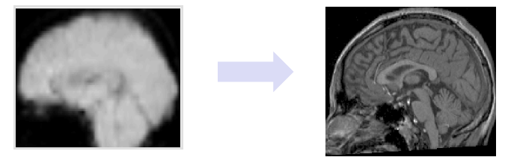
Pipeline: 7. Coregistration
We coregister the functional images to the structural image:
– Allows one to visualize single-subject task activations overlaid on the individual’s anatomical information
– Simplifies later transformation of the fMRI images to a standard coordinate system

Slide 15
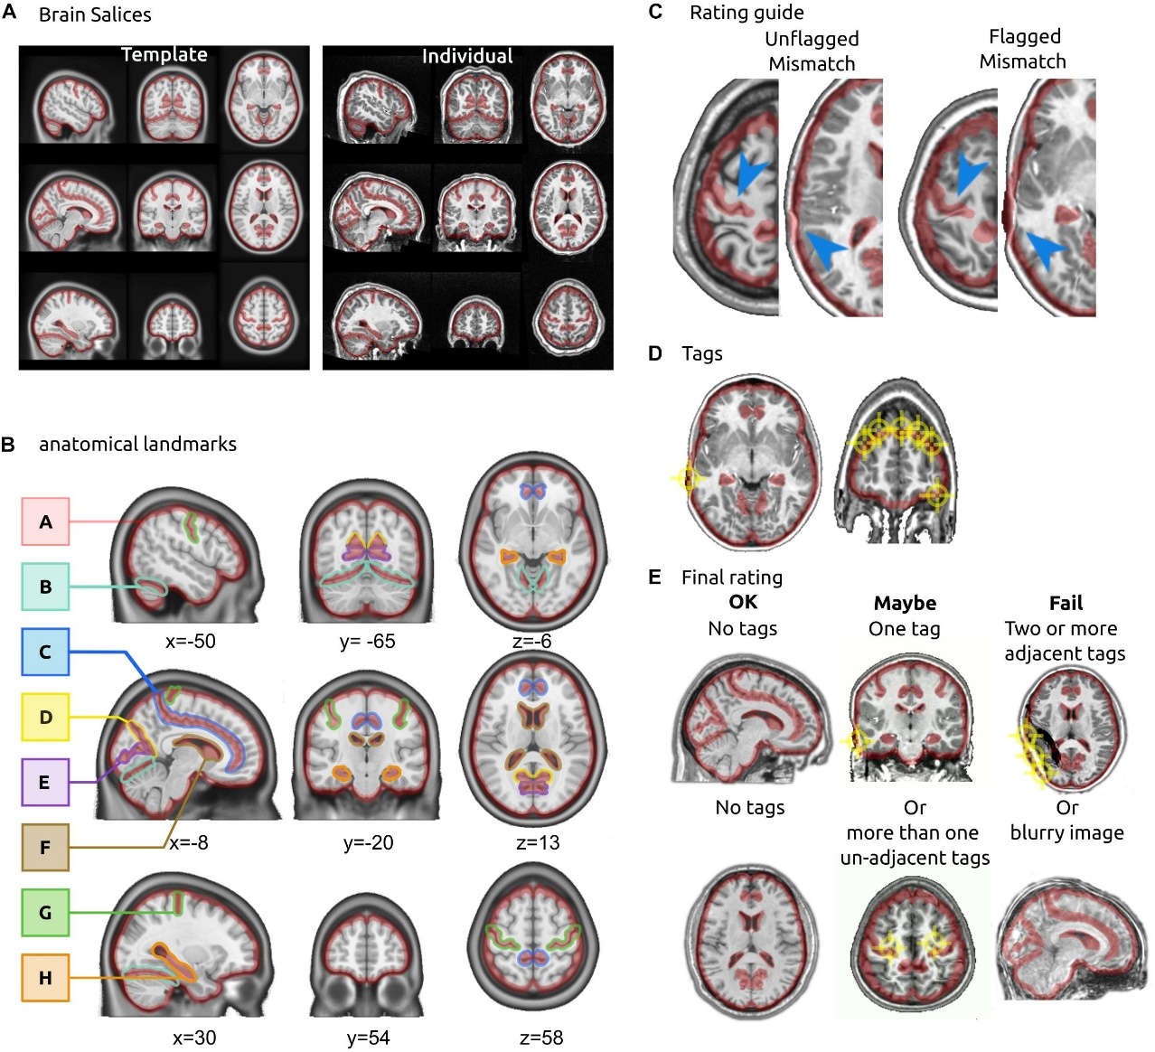
Pipeline: 8. Check registration and corrections

Slide 16
Pipeline: 9. Segmentation (tissue probability maps)
The brain is composed of two main tissue types:
Grey matter (containing high densities of unmyelinated neurons)
White matter (containing high densities of myelinated neurons).
The brain is also surrounded by cerebrospinal fluid (CSF), and large amounts of CSF are contained in internal spaces within the brain called ventricles.
Knowing which voxels belong to which tissue type can assist in the next steps of preprocessing (Normalizing the anatomical image, warping it to match a template in standardized space).
SPM has images of six tissue priors representing their best guess as to which voxel in standardized space belongs to which tissue type. Accurately mapping the tissues of our anatomical image to the tissues of the template will increase the accuracy of our registration.
Why six? Because the anatomical image also contains non-brain tissues:
Soft tissue (e.g., dura mater)
Skull
All other tissues not captured by any of the above; usually air inside the sinuses and outside the brain, or abnormal tissue, such as tumors

Slide 17
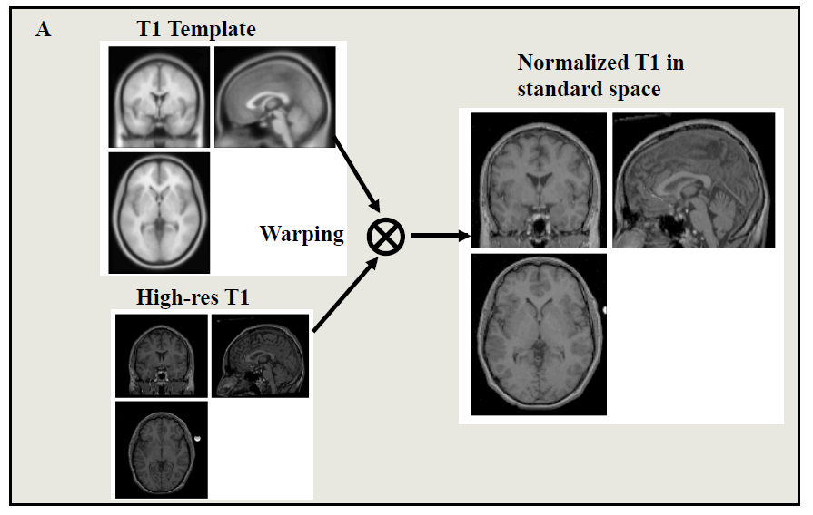
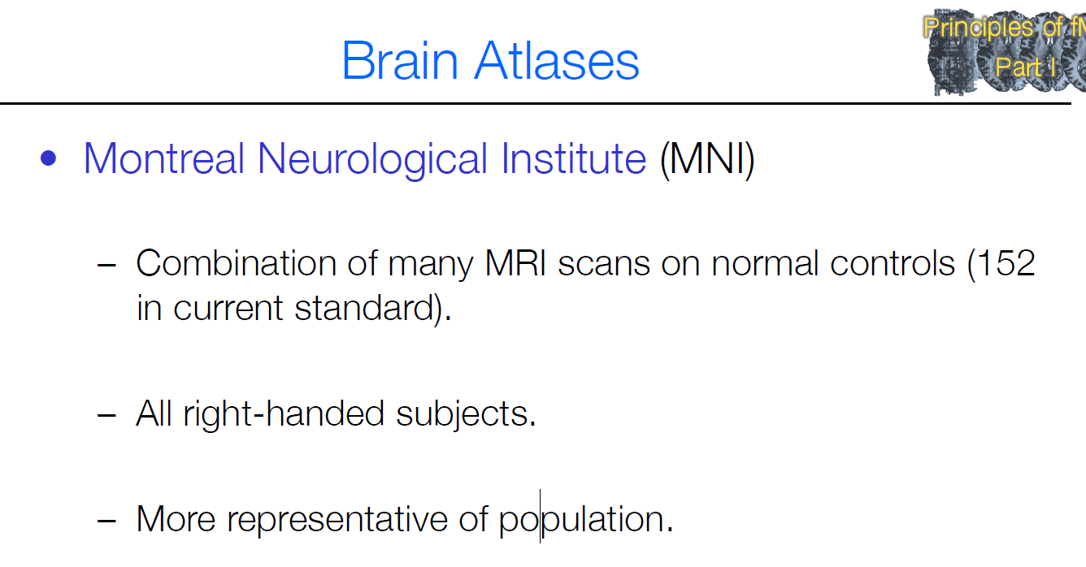
Pipeline: 10. Normalization
• All brains are different. The brain size of two subjects can differ in size by up to 30%
• There may also be substantial variation in the shapes of the brain
• Normalization allows one to stretch, squeeze and warp each brain so that it is the same as some standard brain
The structural MR image used in the coregistration
procedure is warped onto a template image
PROS
• Spatial locations are consistent
• Results can be generalized to larger population
• Results can be compared across studies.
• Results can be averaged across subjects
CONS
• Reduces spatial resolution
• Introduces potential errors

Slide 18
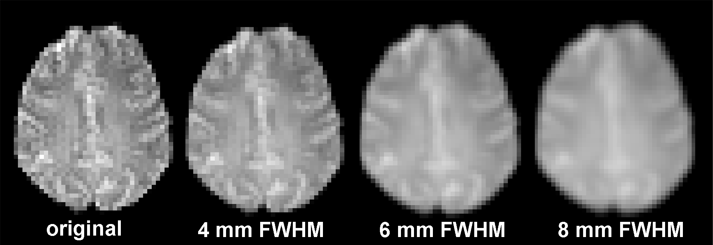
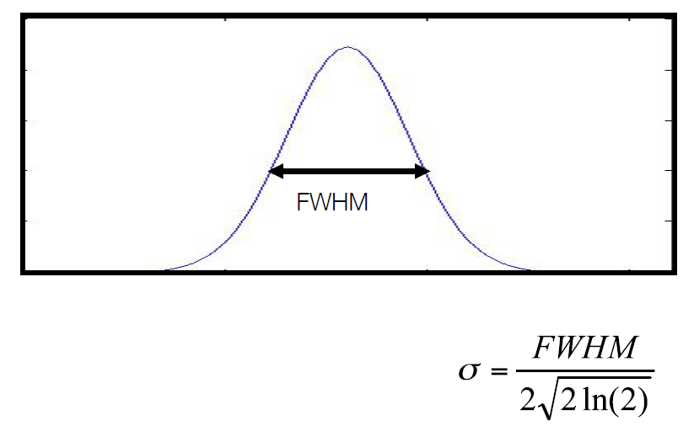
Pipeline: 11. Smoothing
PROS
May overcome limitations in the normalization by blurring any residual anatomical differences
can cancel out the noise and enhance the signal, increasing the signal-to-noise ratio (SNR)
May increase the validity of the statistical analysis
Required for Gaussian random fields
Because spatial normalization across subjects is imperfect, activations in e.g., hippocampus will not line up perfectly in a group analysis.
Spatial smoothing consists in averaging over nearby voxels (e.g., 4mm, 10mm) so it is more likely that activations overlap and therefore are detected.
CONS
The image resolution is reduced
Smoothing consists in applying a Gaussian filter to voxels:
We choose a kernel size for the Gaussian filter, called full width at half maximum (usually 3*voxel size)
The data is averaged over the width of the FWHM.
Notes:
Imagine that every subject in an fMRI experiment showed activity in a particular portion of the left inferior frontal gyrus. However, because spatial normalization across subjects is imperfect, these activations will not line up perfectly in a group analysis. Smoothing the data makes it more likely that the activations will overlap, and thus be detected, despite errors in normalization.
The standard procedure of spatial smoothing is employed by convolving the fMRI signal with a Gaussian function of a specific width.This so called Gaussian kernel is a kernel with the shape of a normal distribution curve. The size of the Gaussian kernel defines the "width" of the curve which determines in turn how much the data is smoothed. The width is not expressed in terms of the standard deviation σ, as customary in statistics, but with the Full Width at Half Maximum (FWHM). For a standard Gaussian with a mean of 0 and a standard deviation of 1, the FWHM would be 2.35: The maximum of this curve is y = 0.4 at x = 0. The half maximum is y = 0.2 at x = -1.175 and at x = 1.175. Therefore, the full width of the curve at the point of the half maximum is about 2.35. Nevertheless, the FWHM is also related to the standard deviation σ as follows: FWHM = σ √(8 ln(2)).
One common rule of thumb is that, to render your data approximately normal, you should smooth with a Gaussian filter approximately three times the size of your voxel. However, some data suggest a FHWM above 8mm is too much

Slide 19
Contrasts on SPM

Slide 20
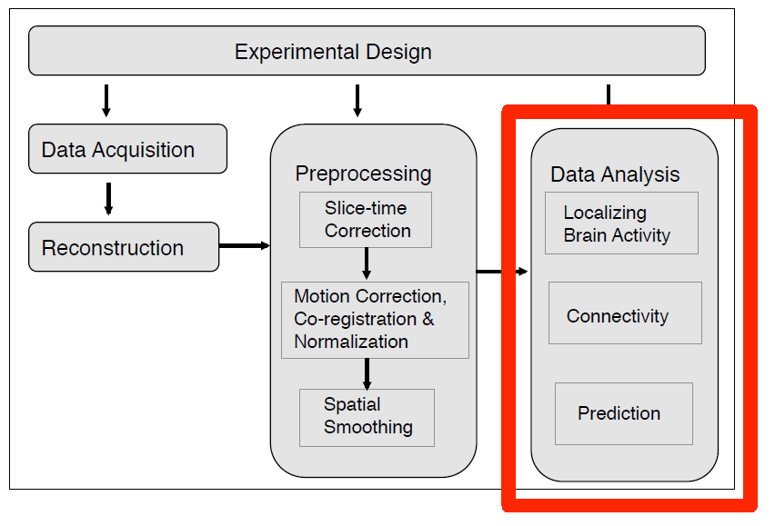
Statistical analyses
Sources: Martin Lindquist and Tor Wager – Principles of fMRI (discontinued)
Notes:
There are multiple goals in the statistical analysis of fMRI data.
• They include:
– localizing brain areas activated by the task;
– determining networks corresponding to brain function; and
– making predictions about psychological or disease states.

Slide 21
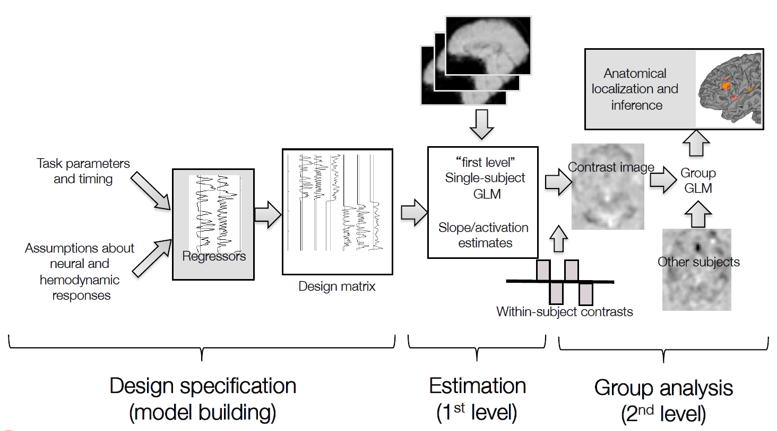
GLM analysis process
Notes:
Typically a two-level hierarchical analysis:
1. Within-subject (individual)
2. Across-subject (group)
• Can be done in stages (1st, 2nd level)
• Hierarchical models combine stages into one model

Slide 22
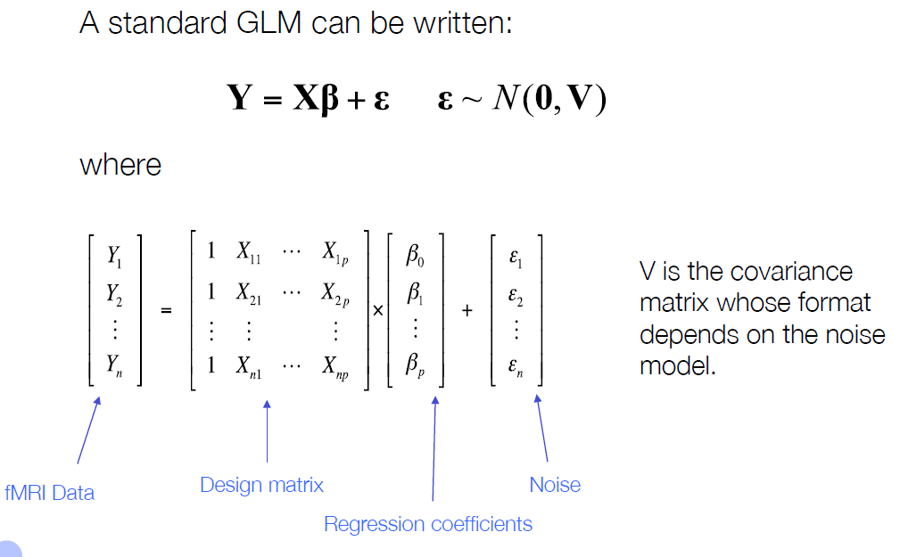
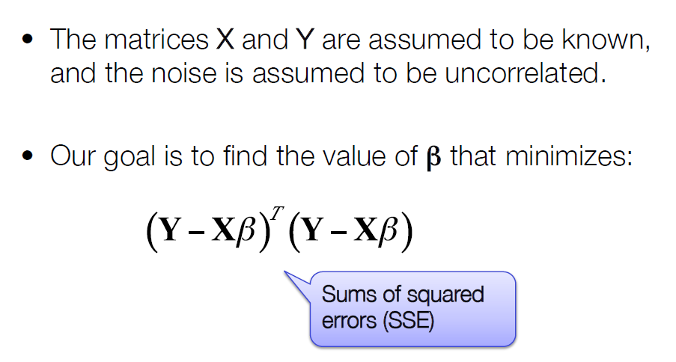
GLM

Slide 23
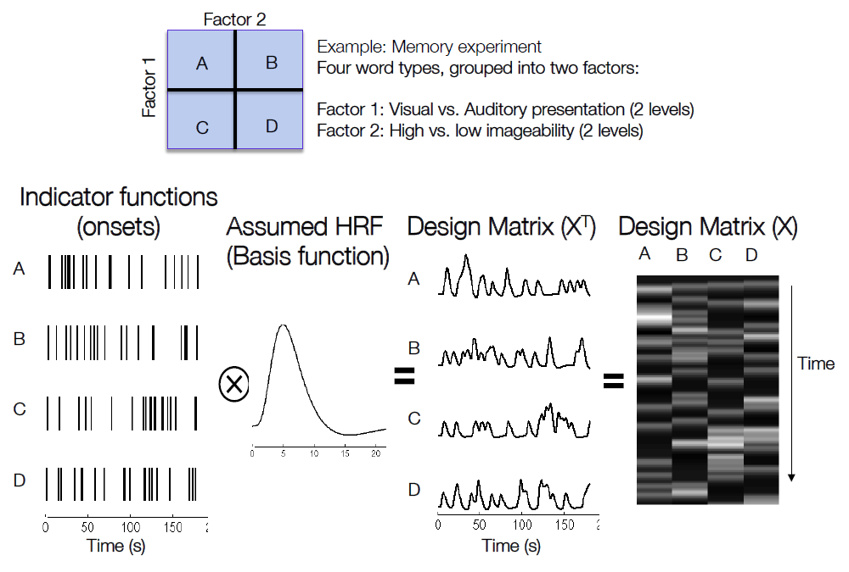
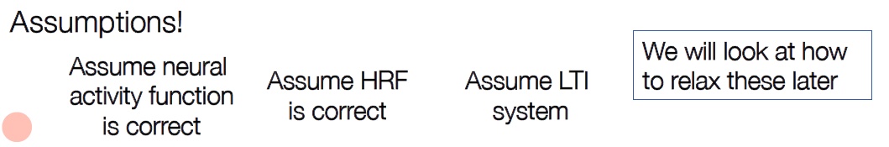
Design specification

Slide 24
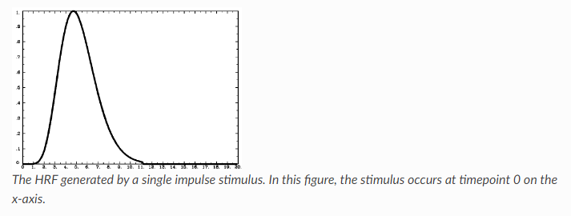
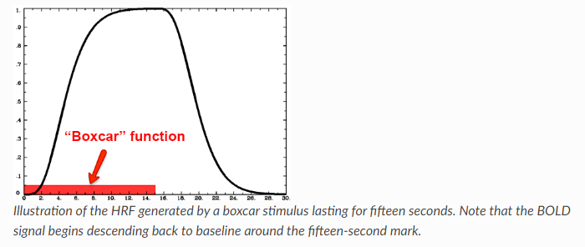
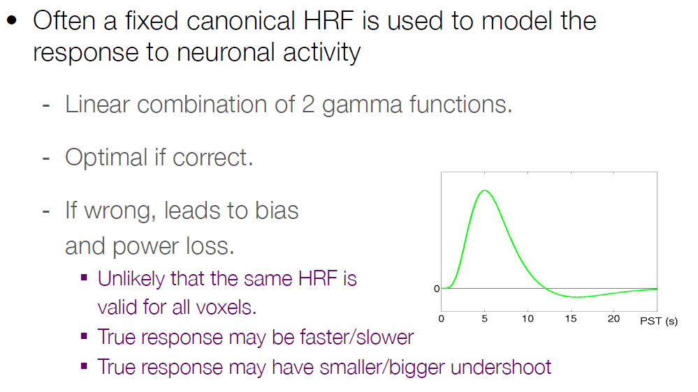
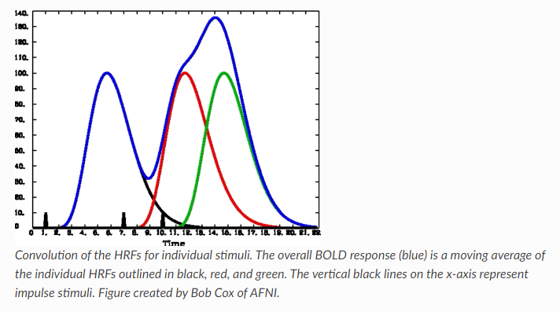
Assumptions about HRF & onsets
Single impulse onset (stimulus)
The BOLD signal follows a consistent shape, peaking around 6s then falling back to baseline over the next several seconds
Boxcar onset (stimulus)
6s
HRF overlap
Notes:
Hemodynamic Response Function:
In the 1990’s, empirical studies of the BOLD signal demonstrated that, after a stimulus was presented to the subject, any part of the brain responsive to that stimulus - say, the visual cortex in response to a visual stimulus - showed an increase in BOLD signal. The BOLD signal also appeared to follow a consistent shape, peaking around six seconds and then falling back to baseline over the next several seconds. This shape can be modeled with a mathematical function called a Gamma Distribution. When the Gamma Distribution is created with parameters to best fit the BOLD response observed by the majority of empirical studies, we refer to it as the canonical Hemodynamic Response Function, or HRF.
When applied to fMRI data, the Gamma Distribution is called a basis function.
What happens if another stimulus is presented before the BOLD response for the previous stimulus has returned to baseline?
In that case, the individual HRFs are summed together. This creates a BOLD response that is a moving average of the individual HRFs, and the shape of the BOLD signal becomes more complex as more stimuli are presented close together.

Slide 25
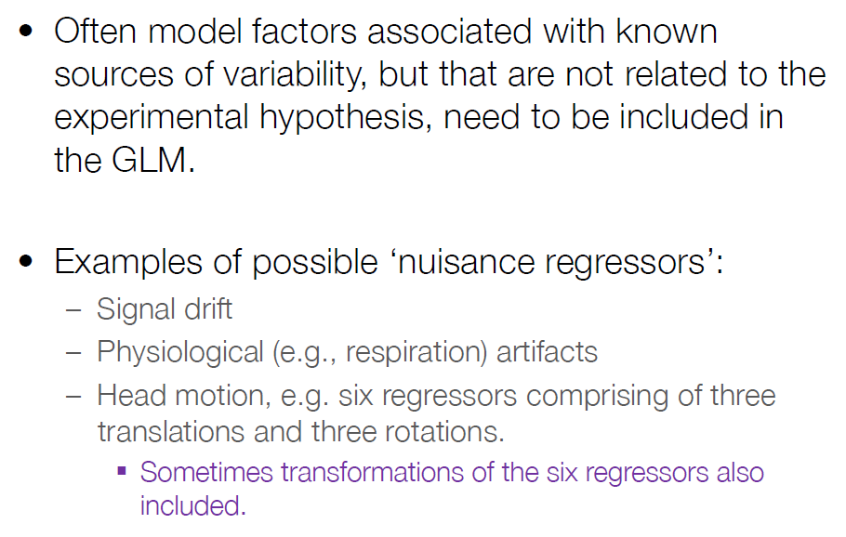
Nuisance covariates
Notes:
May need to include:
Drift: Slow changes in voxel intensity over time (low frequency noise) is present in the fMRI signal.
Scanner instabilities and not motion or physiological noise may be the main cause of the drift, as drift has been seen in cadavers.
Need to include drift parameters in our models: Use splines, polynomial basis or discrete cosine basis
High-pass filtering
Physiological noise such as respiration, heart beat – that give rise to periodic noise
Motion, such as head movements

Slide 26
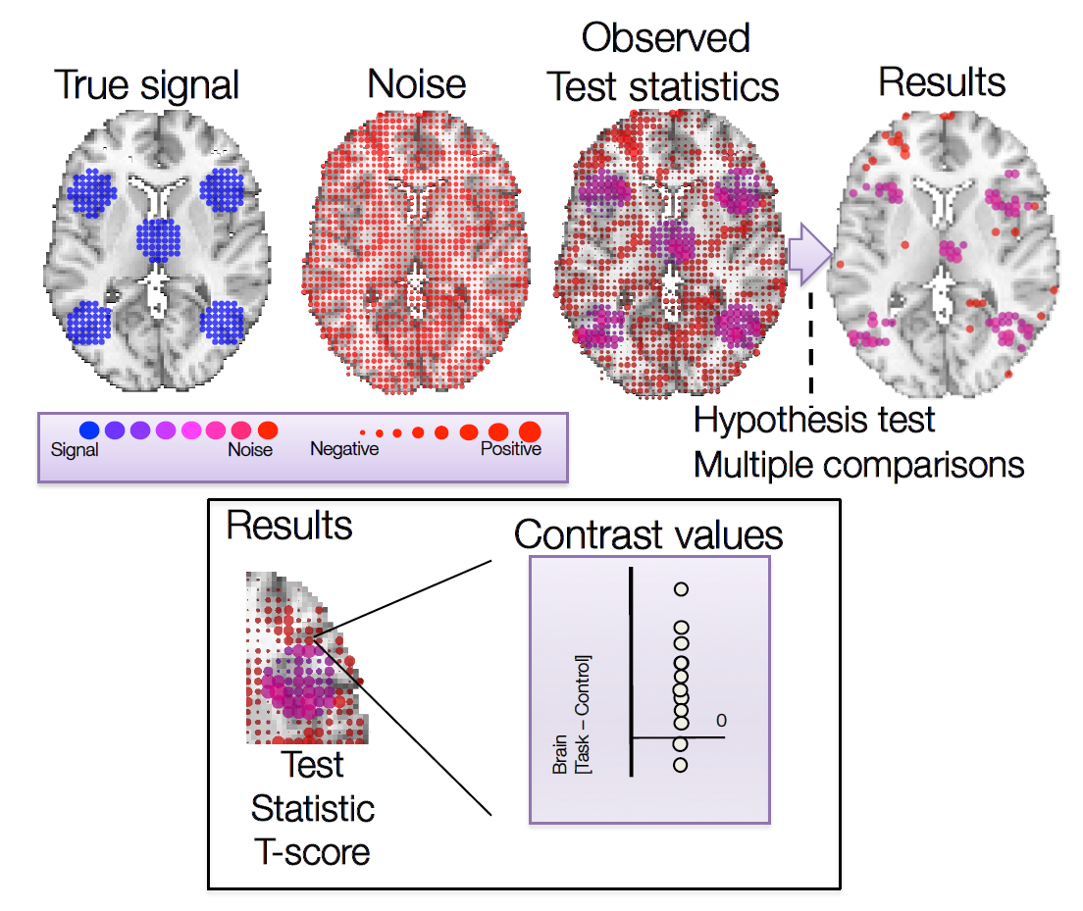
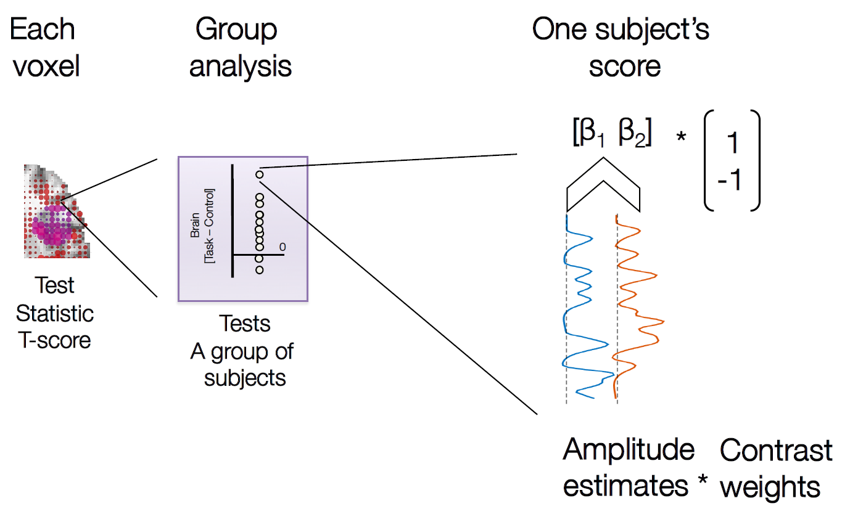
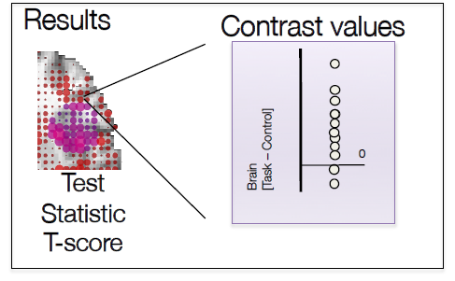
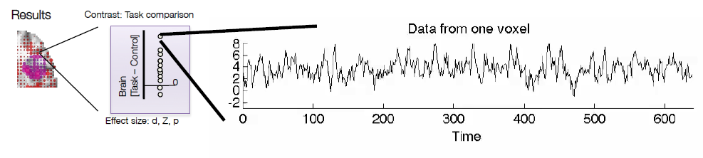
Estimation (single subject GLM)

Slide 27
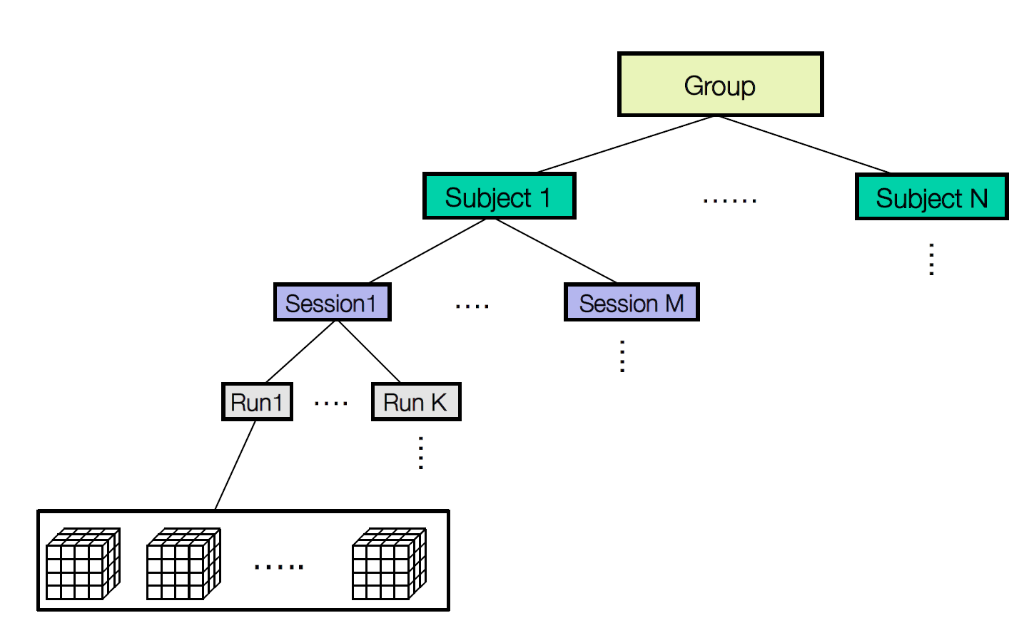
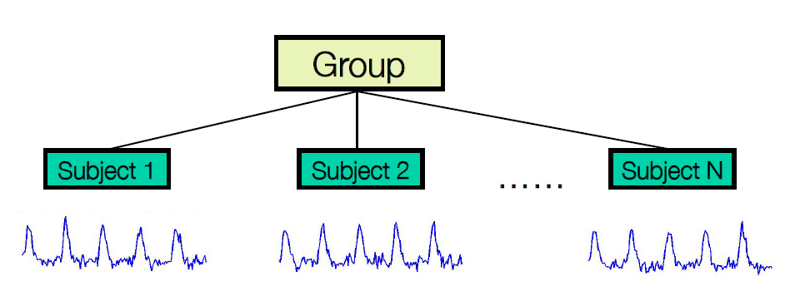
Group analysis
Data is hierarchical in nature: lower-level observations nested within higher levels
2nd Level
1st Level

Slide 28
Estimation (group GLM)

Slide 29
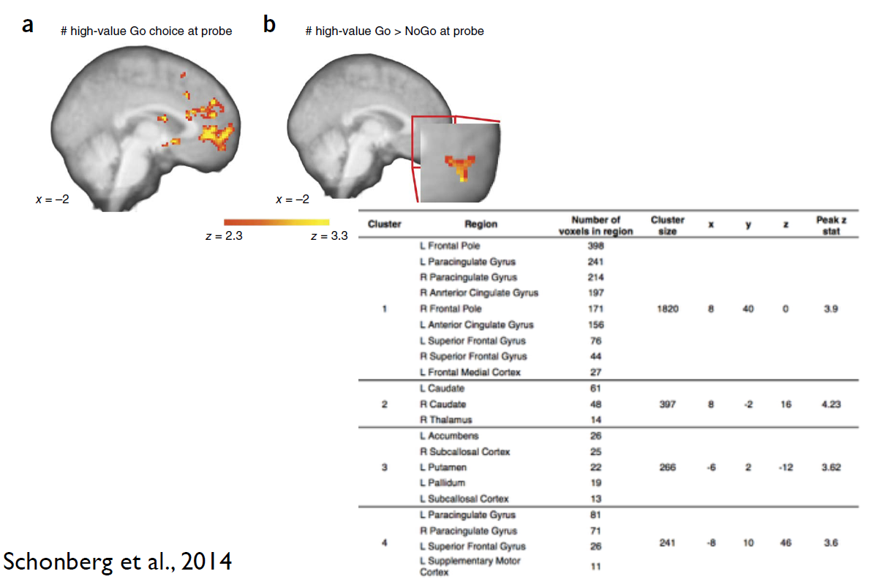
Guidelines: reporting contrasts & tables
Source: Russell Poldrack – Reporting fMRI data

Slide 30
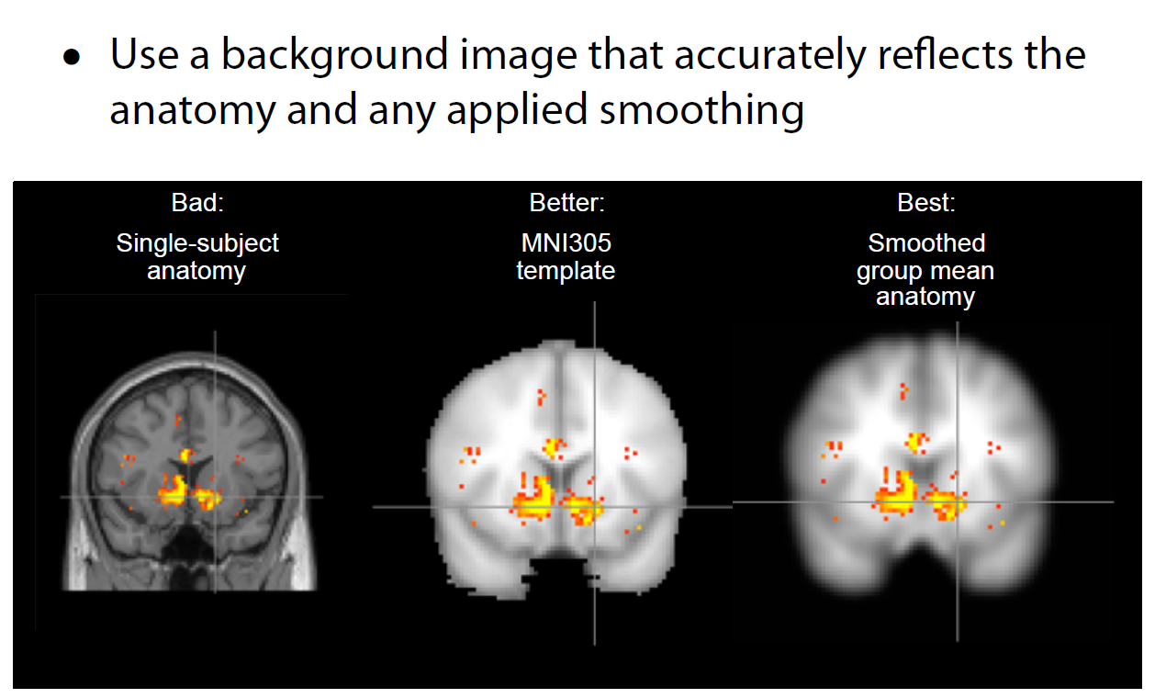
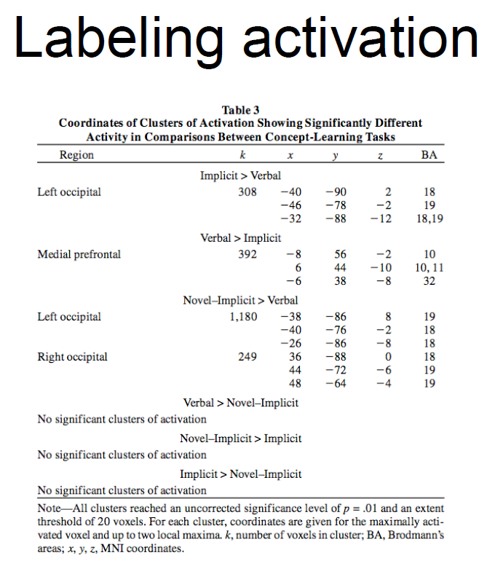
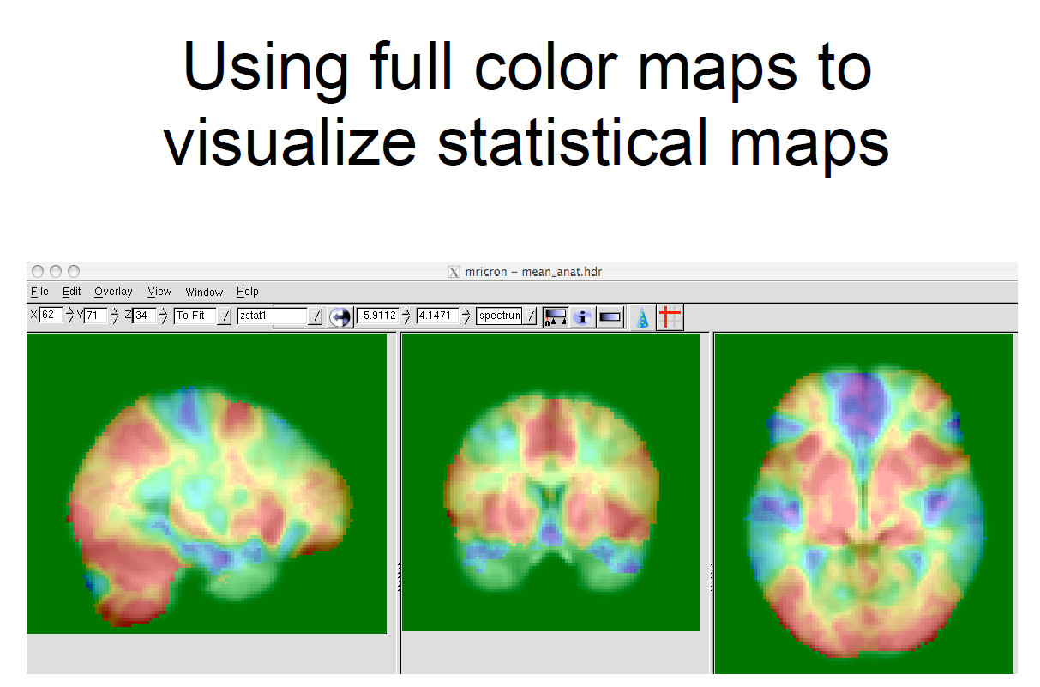
Guidelines: reporting contrasts & tables
Better use probabilistic anatomical maps, not Talairach&Tournoux + Brodmann areas
MNI recommended (152S)

Slide 31
Guidelines: using ROI analysis
• Characterize/explore signal
• Limit correction for multiple comparisons
• Examine functionally characterized Regions
• With complex designs, it is often difficult to tell what is going on simply by looking at maps
• Plotting signal from ROIs can be Enlightening
• Control for multiple tests over the whole brain can be highly conservative
• Limiting the number of tests (voxels) can increase power
– Only when you have a pre-existing anatomical hypothesis
– Can’t do this based on the results of another analysis of the same data!
Example
• P<.001, whole brain (2410 resells [smoothed voxels])
– Cluster with 41 voxels: • P=0.465
• P<.001, small volume correction for 10mm radius sphere (5.7 resels)
– Same cluster: p=.002
Notes:
Resel = 'resolution element'.
The number of resels is a measure of volume that can be thought of as normalized for intrinsic smoothness.
It is independent of voxel size.
The size of a resel, expressed in voxels, is the FHWH of a Gaussian smoothing kernel that would produce the same smoothness in voxel-space.

Slide 32
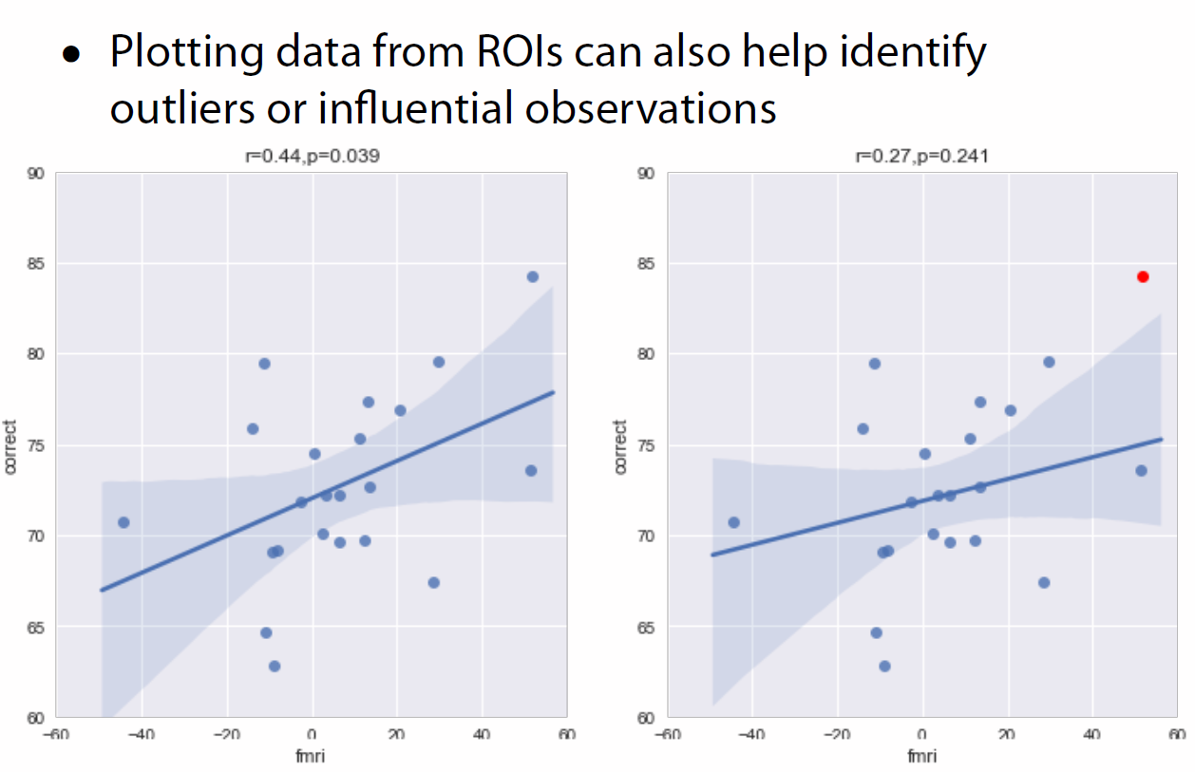
Guidelines: detecting outliers

Slide 33

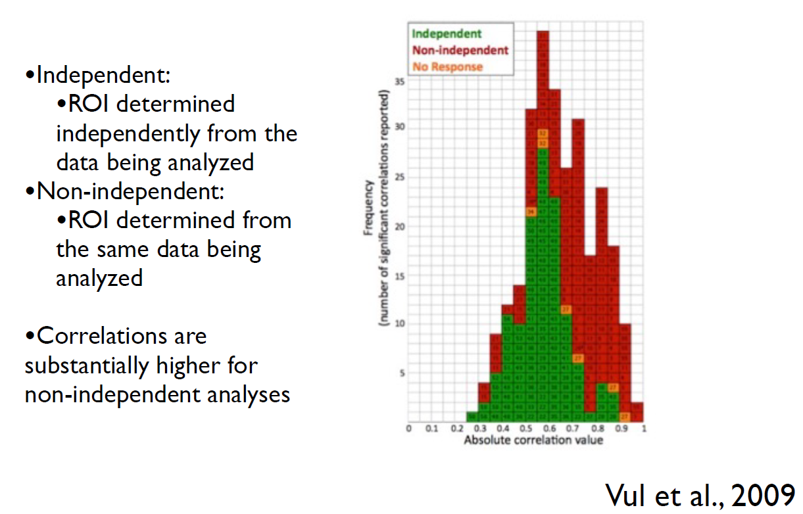
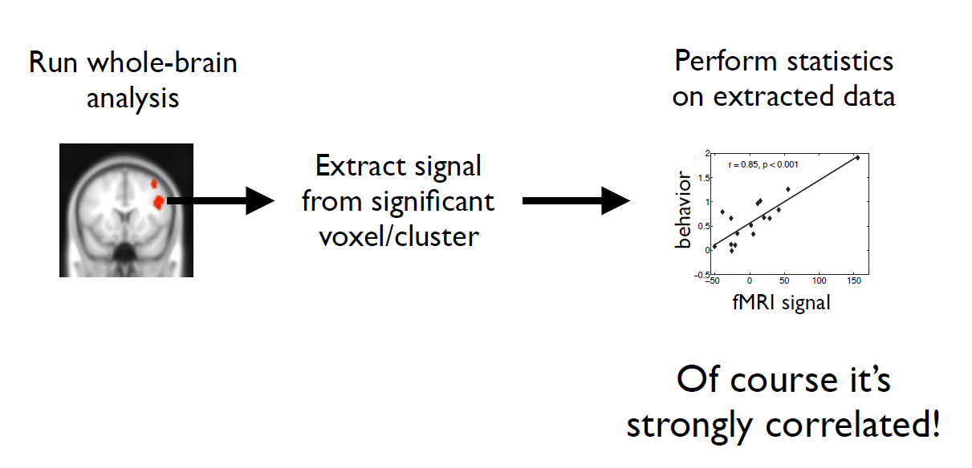
Guidelines: bias and circularity
Notes:
E.g., If one selects only voxels in which condition A produces a greater signal change than condition B, and then evaluates whether the signal change for conditions A and B differ in those voxels using the same data, the second analysis is not independent of the selection criteria
Independence problem/Spurious correlations: Computing separate correlations for individual voxels and reporting means of only those voxels exceeding chosen thresholds
In other words, data selected on the basis of an initial statistical test are subjected to one or more further (non-independent) statistical test(s).
In statistical hypothesis testing, the most common non-independence error is referred to as ‘selection bias’. Essentially all statistical models used for hypothesis testing assume that the sampling (selection) process is independent of the relevant measure. ‘Selection bias’ is a violation of this independence assumption
The non-independence error arises in fMRI when a subset of voxels is selected for a subsequent analysis, but the null-hypothesis of the analysis is not independent of the selection criteria used to choose the voxels in the first place.
Take the simplest practical case: If one selects only voxels in which condition A produces a greater signal change than condition B, and then evaluates whether the signal change for conditions A and B differ in those voxels using the same data, the second analysis is not independent of the selection criteria

Slide 34
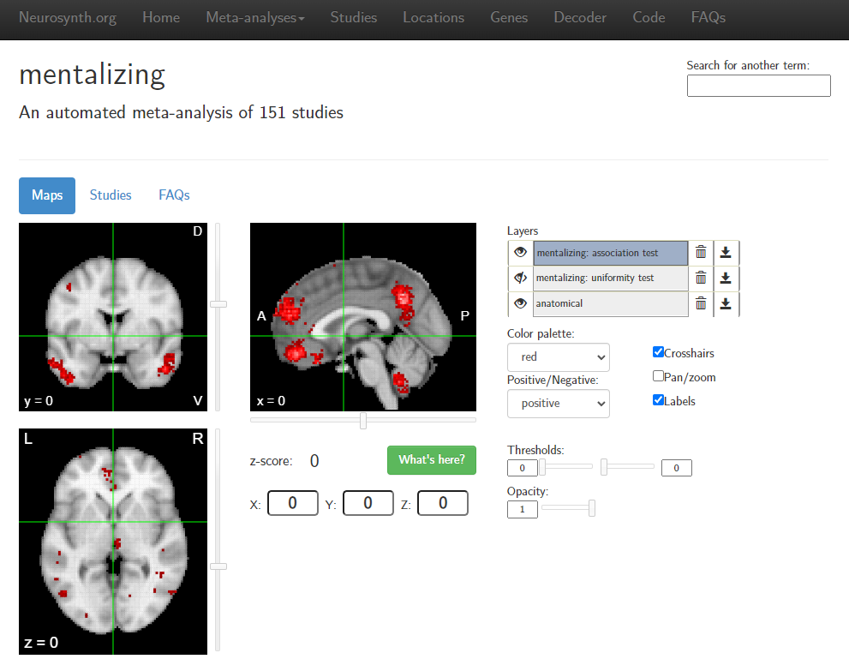
Guidelines: Using neurosynth.org to obtain a priori ROIs

Slide 35

Guidelines: transparent reporting of methods

Slide 36
Guidelines: more publications
Poldrack, R. A., Baker, C. I., Durnez, J., Gorgolewski, K. J., Matthews, P. M., Munafò, M. R., ... & Yarkoni, T. (2017). Scanning the horizon: towards transparent and reproducible neuroimaging research. Nature reviews neuroscience, 18(2), 115-126.
Nichols, T. E., Das, S., Eickhoff, S. B., Evans, A. C., Glatard, T., Hanke, M., ... & Yeo, B. T. (2017). Best practices in data analysis and sharing in neuroimaging using MRI. Nature neuroscience, 20(3), 299-303.
Devlin, J. T., & Poldrack, R. A. (2007). In praise of tedious anatomy. Neuroimage, 37(4), 1033-1041.
Poldrack, R. A., & Mumford, J. A. (2009). Independence in ROI analysis: where is the voodoo?. Social cognitive and affective neuroscience, 4(2), 208-213.
Vul, E., Harris, C., Winkielman, P., & Pashler, H. (2009). Puzzlingly high correlations in fMRI studies of emotion, personality, and social cognition. Perspectives on psychological science, 4(3), 274-290.
Etc.

Slide 37
Toolboxes, softwares and platforms
Toolboxes
ARTrepair: repairs scans with artifacts (e.g., head movements)
AAL1: automated anatomical parellation of T1 volumes (provided by the MNI)
AAL2: alternative parcellation of the OFC
AAL3: alternative parcellation of the anterior cingulate, thalamus and some brain nuclei
CONN: connectivity toolbox that loads .SPM designs
MarsBaR: fo regions of interest (ROIs)
Softwares
Mango: visualizer
MRIcrogl: visualizer that supports scripting; better for publications
BrainNetViewer: visualizer for connectivity; can save movies
RFXplot: data visualisation for 2nd level analyses
WFU_PickAtlas: generation of ROI masks based on the Talairach Daemon database (Brodmann area, Lobar, Hemisphere, Anatomic Label and Tissue type)
Xjview: rendering software; loads .SPM; functions for ROI selection, pValue slider, multiple images display, common area analysis, etc.
Platforms
Neurosynth.org: platform for large-scale, automated synthesis of fMRI data
OpenNeuro.org: platform for open-source validating and sharing BIDS-compliant data
andysbrainbook.readthedocs.io: comprehensive tutorials for brain data analyses, paired with https://www.andysbrainblog.com/

Slide 38
Preprocessing on SPM – practical work

Slide 39





Pipeline: 1. DICOM to NifTI

Slide 40
Pipeline: 2. Visualization
Inspect functional images
Inspect anatomical images
Look out for noise, transient artiacts, ghosting, dropouts, etc.
Look out for artifacts, such as ripples. They may be caused by subjects moving too much in the scanner

Slide 41
Pipeline: 3. Artifact removal (optional)
Can also be done at the end of preprocessing
Beware, previous versions included a script error that needed correction by-hand. Unfortunately, we forgot what was the error specifically
https://cibsr.stanford.edu/content/dam/sm/cibsr/documents/tools/methods/artrepair-software/ArtRepairOverview.pdf

Slide 42


Pipeline: 4. Field Map
(Calculate Voxel Displacement Maps VDM), 7 steps
Same fieldmap file with the “01” suffix; located at the first fieldmap folder of each participant (gre_fieldmap_mapping…..)
2. Same fieldmap file with the “02” suffix; located at the first fieldmap folder of each participant
(gre_fieldmap_mapping…..)
3. File pm_defaults_studiesM.m
4. Choose the first image from each session of the participant
!
5.
Keep in mind the order of sessions and use them consistently throughout the rest of the preprocessing steps.
6.
7.

Slide 43


Pipeline: 5. Slice timing
For each participant and each functional session (run 1-6), select the corresponding .nii files
These parameters were established in collaboration with Primage tech team.
TA=TR-(TR/nslices)
Type in the dialog box:
[1:2:45 2:2:45]
Specify : 1

Slide 44




Pipeline: 6. Registration (Realign & unwarp)
1. Use the dependency button to specify the file corresponding to each sessions (“a” suffix images ).
2. Use the dependency button to specify the file corresponding to each session
Phase map
!
Mind the numbering of sessions: they are serial according to spm and not the original numbers
3. Do not modify the rest of parameters
Verify that file prefix is “u”

Slide 45


Pipeline: 7. Coregistration
1. Reference image: click on dependency button and select : Unwraped Mean Image
2. Specify the T1 anatomical scan (T1_MPR_SAG….Folder)

Slide 46



Pipeline: 8. Check registration and movement corrections
Select T1 anatomical image
Type: mean at the filter (right box) and select the mean image located at the folder containing the first run from the experiment.
Click Done

Slide 47


Using the mouse to navigate, move around the brain volume and:
Verify that red lines (corresponding to the functional images) follow closely the brain perimeter.
Verify anatomical features: i.e. ventricules, white and grey matter, cerebellum, etc.
Check for mismatchs as shown below
(http://imaging.mrc-cbu.cam.ac.uk/meg/RepositioningMRIs)

Slide 48

Mismatches may need to correct the alignment of the functional (EPI) image run by run.
Using the manual alignment toolbox, adjust the images trying with different distances along the 3 axis.
Check the corrections at the Graphics window and once image is correctly fitted, click on the button
In the file selection box,
Select all (^) “ua” prefix images
And click DONE
Launch again the check reg from the SPM menu and check that corrections were correctly applied to all runs. Use one functional image with “ua” prefix from one run and overlay on top of T1
Watch out radian units: use values < 0; i.e., 0.01

Slide 49



Pipeline: 9. Segmentation
T1 image
For tissue 1 to 3:
Click on Native tissue and select Native+ Dartel imported from the current box items below.
Use a batch with all participants so that all segmentation is done before doing DARTEL
For the rest of tissues (4 to 6):
Select None

Slide 50

Segmentation output are 3 images with the “RC” prefix which will be saved at the T1 folder.
rc1*.nii files = grey matter
rc2*.nii files = white matter
rc3*.nii files = CSF
Images will be saved at the T1 folder
Output:
rc1*.nii file
rc2*.nii file
rc3*.nii file
For each participant

Slide 51

Pipeline: 10 & 11. Normalization (DARTEL + MNI Space normalization + Smoothing)
The Diffeomorphic Anatomical Registration Through Exponentiated Lie Algebra (DARTEL, Ashburner 2007) Toolbox is a high dimensional warping process that increases the registration between individuals, which results in improved localization and increased sensitivity in analyses.
Run DARTEL (create a template)
Needs all segmentation rc files and batch 1 processes to be ready before launching!
The whole procedure takes (in the order of) about a week of processing time for 400 subjects

Slide 52


Click at the images field and create 3 fields for each image
First field will correspond to rc1 images from all subjects
Second field will correspond to rc2 images from all subjects
Third field will correspond to rc3 images from all subjects
KEEP THE SAME ORDER WHILE ADDING FILES!
The first rc1*.nii is assumed to correspond with the first rc2*.nii from the same subject, the second with the second, and so on..
The template for all-participants will be saved at the T1 folder of the first participant:
Output = u_rc1*.nii file aka “flow fields”

Slide 53




Using dependency button, specify the last of the series of templates that was created by RunDartel (create Template). This is usually called Template_6.nii
The file is usually located at the T1 folder from first participant from the DARTEL template batch.
For fMRI analyses,
Select according to : Few Subjects
This will display new fields for adding files (see next slide)

Slide 54


Add as many subjects as needed and then :
Flow Field: specify the u_rc1* image of the subject (T1 folder)
Images: add all the ua functional images (type in the filter .*^ua) from all runs (training to 6)
There is no need to separate by run
Hit to run
Output = smwc1*.nii files
Stored folderwise for each participant

Slide 55
Contrasts on SPM - practical work

Slide 56


Design specification: single-subject
Output directory
Following the fMRI machine settings chosen for the experiment
TR (repetition time)
t: number of time-bins per scan
t0: reference time-bin
Select the subject’s preprocessed scans (affix: vswuaf)
e.g., control
Vector of onset times
e.g., head movements
Vector of duration for each onset: stick function: duration=0 boxcar=real number
Vector of values

Slide 57

Design output: single-subject
Sn(1): time series for session 1
Sn(2): time series for session 2
Inc: time series for condition with incongruent stimuli
Con: time series for condition congruent stimuli
Constant: baseline regressors that capture the mean signal for each session

Slide 58

Estimating the model: single-subject
Select the SPM.mat for our specified design
Select Yes

Slide 59


Contrasts specification: single-subject
t-test
incongruent (Session1&Session2) > congruent(Session1&Session2)

Slide 60


Output: single-subject
results -> overlays -> sections -> spm12/canonical -> avg152

Slide 61

Scripting: single-subject
The Batch module we have just created is specific to 1 subject. If you clicked on the green Go button, it would run all of the preprocessing and model estimation steps in one go. With a few adjustments, however, we can adapt this module to all of the other subjects in our study.
First, we need to save the modules into a Matlab script. Click on File -> Save Batch and Script, and label the file RunPreproc_1stLevel. Save it to the directory that contains all of your subjects. This will create a Matlab script file that you can open in the Matlab window.
From the Matlab terminal, navigate to the directory which contains the RunPreproc_1stLevel.m script, and type
open RunPreproc_1stLevel_job.m
To adapt this file so that it can analyze any subject, we will need to store in a variable the different subject numbers and place the existing code in a for-loop which will run over a set of numbers indicating each subject in the study.

Slide 62


Design specification: group-level
Output directory
Contrasts con_*.nii for all subjects
e.g., age
According to a voxel value: Explicit mask = exclusively includes voxels with that value; Implicit mask = excludes voxel with that value
Notes:
We will run a group-level analysis (also known as a second-level analysis).
In SPM, this means that we calculate the standard error and the mean for a contrast estimate, and then test whether the average estimate is statistically significant.
We will be doing this group-level analysis using a summary statistic approach which ignores the variability in the parameter estimates, and performs a t-test over the mean parameter estimates from each subject.

Slide 63

Contrasts specification: group-level
Group-level t-test
incongruent (Session1&Session2) > congruent(Session1&Session2)
apply masking -> none
p value adjustment to control -> none
threshold {T or p value} -> 0.001
& extent threshold {voxels} -> 20
This will threshold the image to only show clusters that are composed of individual voxels each passing a threshold of 0.001.

Slide 64
Additional notes

Slide 65
fMRI terminology
Session. The experimental session encompasses the time that the subject enters the scanner until they leave the scanner. This will usually include multiple scanning runs with different pulse sequences, including structural, diffusion imaging, functional MRI, spectroscopy, etc.
Run. A run is a period of temporally continuous data acquisition using a single pulse sequence.
Volume. A volume (or alternatively “frame”) is single 3-dimensional image acquired as part of a run.
Condition. A condition is a set of task features that are created to engage a particular mental state.
Trial. A trial (or alternatively “event”) is a temporally isolated period during which a particular condition is presented, or a specific behavior is observed.
Event. The term “trial” and “event” are often interchangeable. However, in certain situations of ‘compound-trials,’ a trial will consist of multiple subunits; for example, a working memory task may contain subunits of encoding, delay, and retrieval. In these cases the subunits are labeled as “events” and the “trial” is defined as the overarching task.
Block. A block (or alternatively “epoch”) is a temporally contiguous period when a subject is presented with a particular condition.

Slide 66

HRFs vary across brain regions and tasks

Slide 67

HRFs vary across brain regions and tasks

Slide 68

Temporal basis functions

Slide 69

Temporal basis functions

Slide 70

Temporal basis functions
Basis sets vary in the degree they make a priori assumptions about the shape of the response, and the HRF shapes they can account for

Slide 71

Temporal basis functions

Slide 72

Temporal basis functions

Slide 73

Temporal basis functions

Slide 74

Temporal basis functions

Slide 75
Checking the preprocessing
https://andysbrainbook.readthedocs.io/en/latest/SPM/SPM_Short_Course/SPM_07_SettingTheOrigin.html

